Slide 1
Bridge Tester ELM-4702 Projects II
Ben Holleran
Carter Mealey

Slide 2
What We Will Discuss
The background of the project
Our solution
System diagrams
Areas of responsibility
Estimated Timeline
Budget
Conclusion

Slide 3
Project Background
Design and build testing equipment compatible with Trotski Competition
Design project to be open source
Budget | $3500
Clients | John Diebold Gordon Reynolds

Slide 4
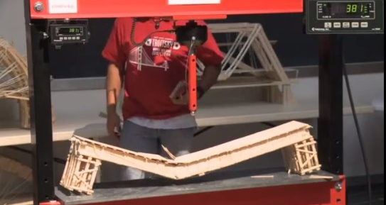
Troitsky Competition
Concordia University
Colleges compete to build the strongest bridge
Strongest bridge was made by MIT and held over six tons
Load display
Crushed Bridge
Piston and piston extender

Slide 5
Troitsky Competition
Started in 1984
1991 first US team
1994, crusher exploded.
Mark on ceiling, Oil everywhere.
New crusher, max 6000lb
2000 new crusher. Hydraulic jack
2010 new crusher. Hydraulic jack

Slide 6
Design Specifications
1 meter span
10 Tons
Mobile enough to move between buildings
Load display visible across Judd Gym
Accurate to 1% Load
Precise to 1% between bridges
14” Piston Throw – Allows different height bridges to be tested

Slide 7
Final Design
Hydraulic Cylinder
Truss instead of I-Beam to save weight
Raspberry Pi as controller
HDMI monitor for force over deflection readout
I²C interface
4” LED 7 segment display for load
Deflection data
Load data

Slide 8
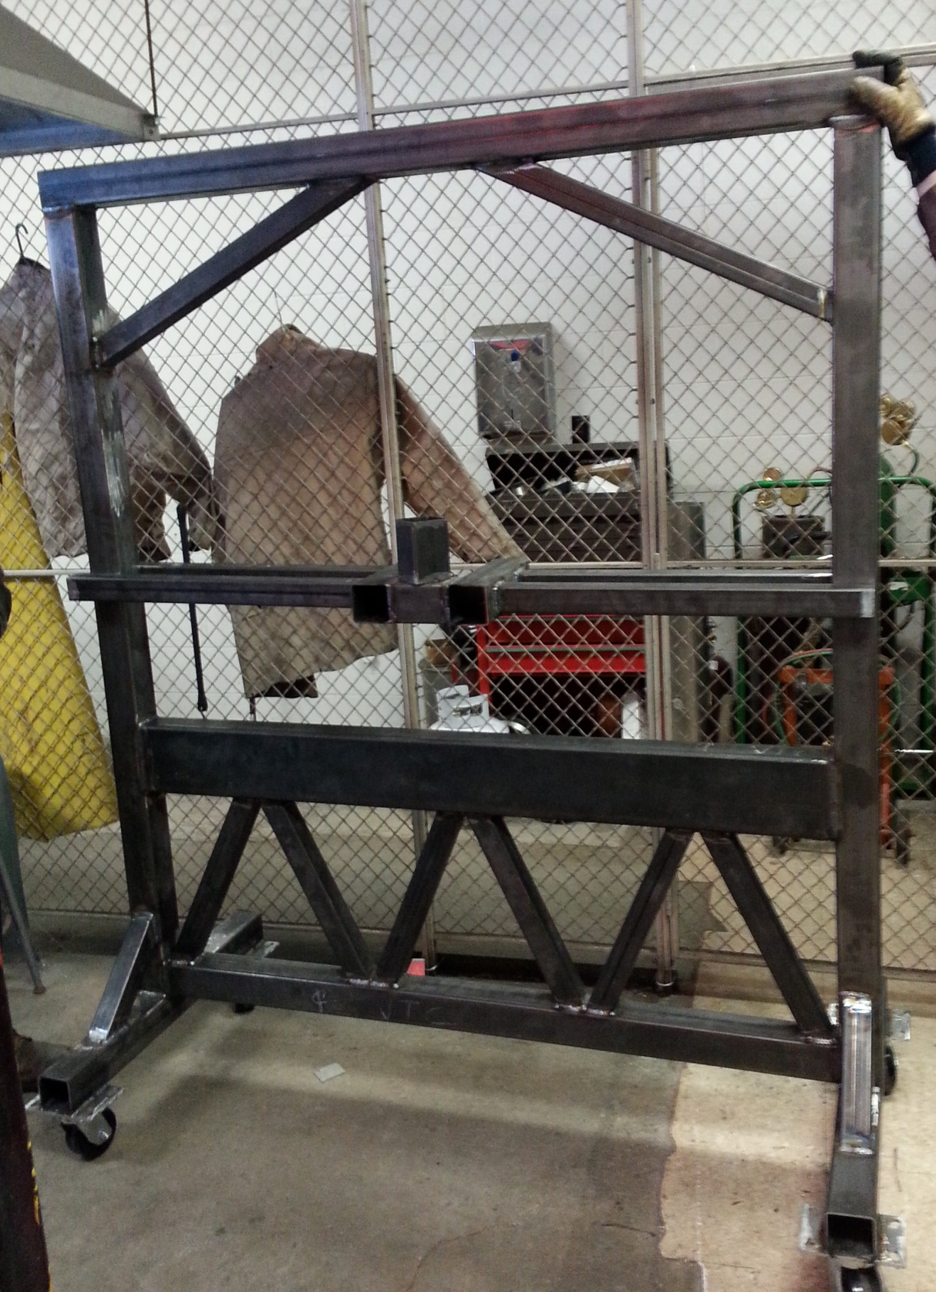
System
Diagram
88888
LCD Screen
Large 7-Segment Display
Bridge Goes Here
Control box:
Raspberry Pi
I2C A2D
Force
Deflection
Switches
Hydraulic System
3in x 3in Hollow
Steel Tubing Frame
Large Castors

Slide 9
Hydraulic Subsystem
1 ½ NPT
¾ NPT
¾-16
½ NPT
Valve has built in pressure relief
¼ NPT
Pressure Sensor
Notes:
Our hydraulic system has is manually operated and has active extend and retract states. It is capable of outputting between 2K-3Ksi of pressure. It has a return tank and a gear pump with a manual handle.

Slide 10
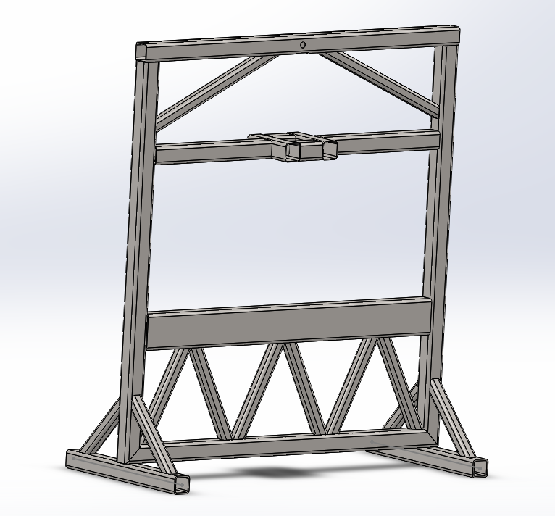
The Frame
Notes:
The frame is the structure that everything else is built on with this project. The above frame on the left shows the structure under maximum load with very exaggerated displacement visuals. There are a few more beams to be added to the frame but we are waiting on other key parts to fabricate mounting requirements after measurements.

Slide 11
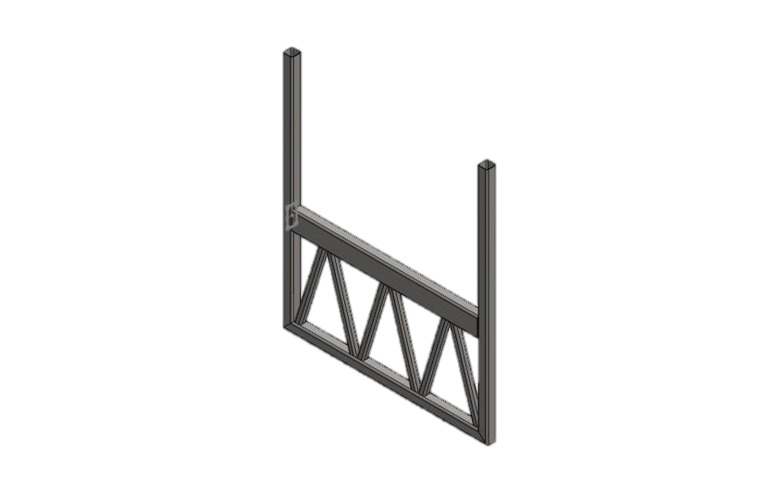
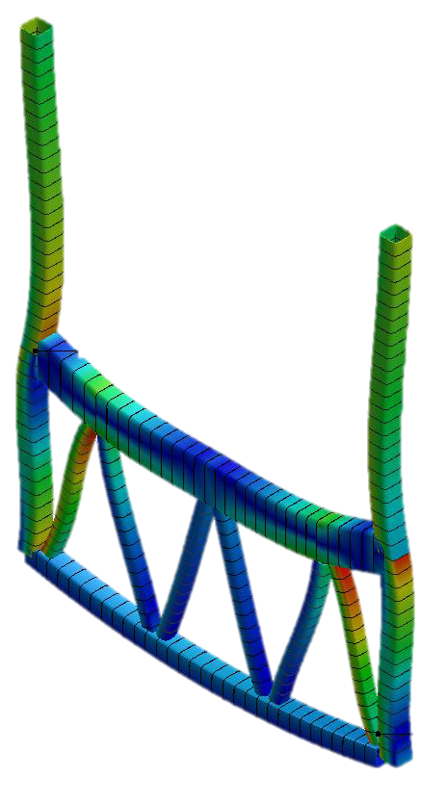
The Frame
Minimum Safety Factor is 4
Truss Is lighter and stiffer than I beam
Notes:
The frame is the structure that everything else is built on with this project. The above frame on the left shows the structure under maximum load with very exaggerated displacement visuals. There are a few more beams to be added to the frame but we are waiting on other key parts to fabricate mounting requirements after measurements.

Slide 12
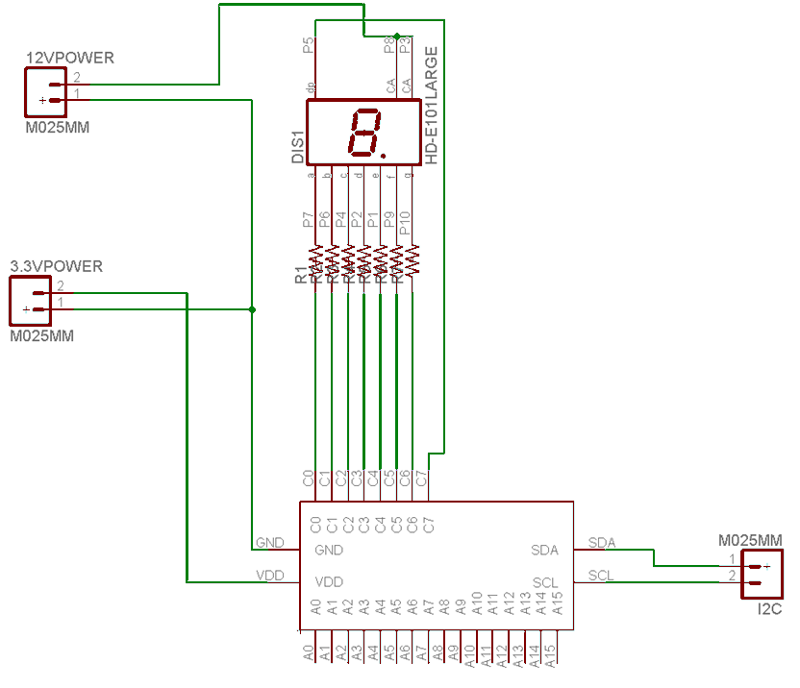
I²C 7 segment schematic
60 ohm
5 identical units will be built, and then given unique addresses

Slide 13
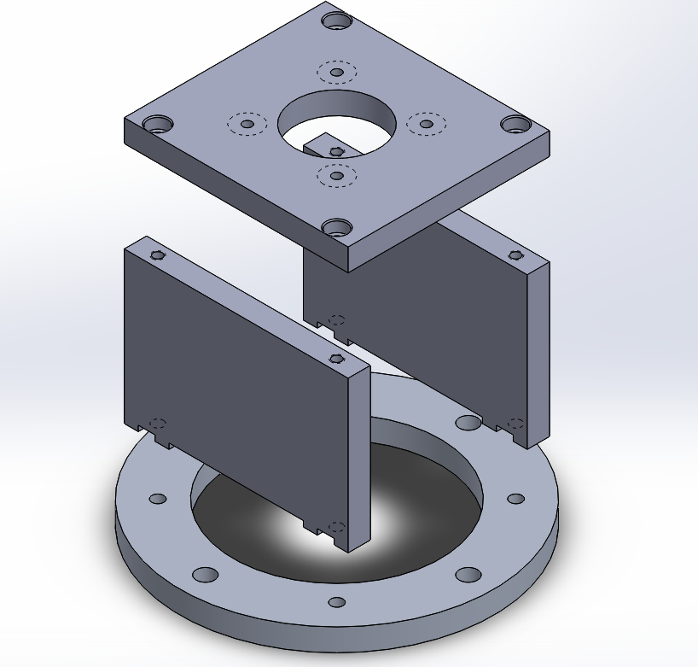
Motor to Hydraulic Pump

Slide 14
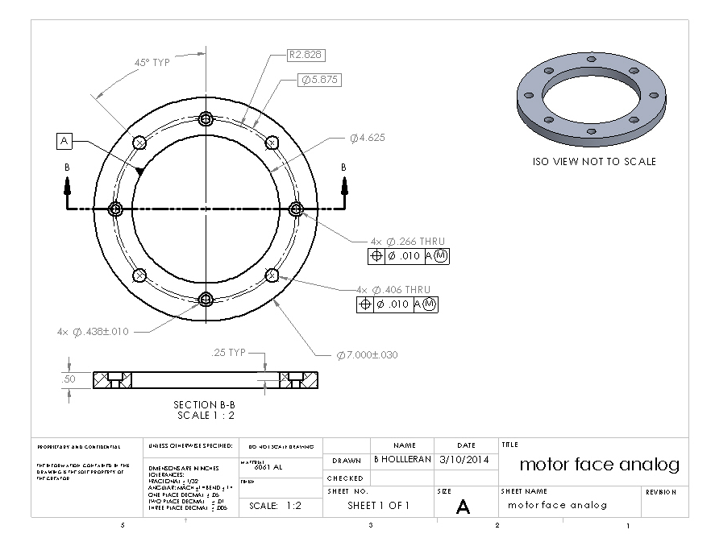
Motor Adaptor Plate

Slide 15
Current Project Status
Frame is welded.
Piston mounting system is designed.
Load display is designed.
Software is designed.
Hydraulics are waiting on bracket to be mounted.
Frame needs more work to be ready to paint.
Load display needs to be built
Software needs to be written.

Slide 16
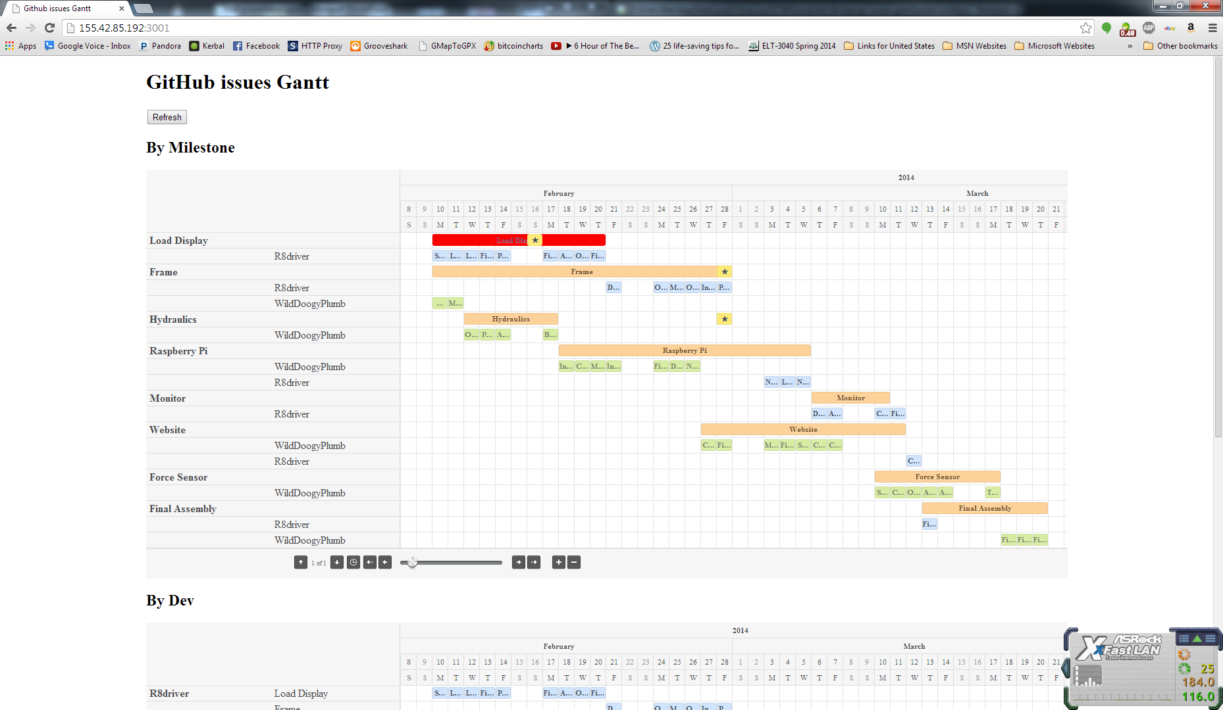
Work Breakdown
Project managed on GitHub
Put Gaant chart screen shot here
Carter Ben
Notes:
Here is our gaant chart with individual responsibilities and subsystems for each category. It shows due dates and what needs to be done in what order. It is available through our website via a link.

Slide 17
Final Budget
Name | Qt | Price | Shipping | Total
Electronics |  |  |  |  | $ 600.95
7 segment display | 5 | $ 16.46 | $ 15.00 | $ 97.30
Rasberry Pi | 1 | $ 55.00 | $ 12.72 | $ 67.72
Monitor | 1 | $ 136.00 | $ - | $ 136.00
hdmi cord | 1 | $ 5.79 | $ - | $ 5.79
i2c ADC | 1 | $ 14.95 | $ 4.07 | $ 19.02
Switches | 1 | $ 5.95 | $ - | $ 5.95
Misc | 1 | $ 150.00 | $ - | $ 150.00
Darlington Array | 6 | $ 2.00 | $ 4.43 | $ 16.43
USB external HDD | 1 | $ 28.00 | $ 7.49 | $ 35.49
7-Seg I2C | 5 | $ 5.95 | $ 7.50 | $ 37.25
Wireless router | 1 | $ 30.00 | $ - | $ 30.00
 |  |  |  | $ -
Hydraulics |  |  |  |  | $ 1,676.16
Pump | 1 | $ 171.75 | $ 24.32 | $ 196.07
Motor | 1 | $ 123.00 | $ - | $ 123.00
Cylinder | 1 | $ 236.50 | $ - | $ 236.50
Sensor (0-5V) | 1 | $391.50 | $ - | $ 391.50
Lines | 5 | $ 100.00 | $ - | $ 500.00
Valve | 1 | $ 85.00 | $ - | $ 85.00
Tank | 1 | $ 70.00 | $ - | $ 70.00
Filter housing | 1 | $ 40.00 | $ - | $ 40.00
Filter Cartridge | 1 | $ 20.00 | $ - | $ 20.00
 |  |  | $ - | $ -
Motor Coupling | 1 | $ 4.22 | $ - | $ 4.22
Pump Coupling | 1 | $ 5.29 | $ - | $ 5.29
Coupling Spider | 2 | $ 2.29 | $ - | $ 4.58
 |  |  | $ - | $ -
 |  |  |  | $ -
Mechanical |  |  |  |  | $ 491.52
Castors | 4 | $ 47.88 | $ - | $ 191.52
Misc Hardware | 1 | $ 300.00 | $ - | $ 300.00
 |  |  | $ - | $ -
 |  |  | $ - | $ -
 |  |  | $ - | $ -
 |  |  | $ - | $ -
 |  |  | $ - | $ -
 |  |  | $ - | $ -
 |  |  | $ - | $ -
Raw Materials |  |  |  |  | $ 315.21
Frame Steel | 0 | $ - | $ - | $ -
0 | .00 ft | $ 2.33 | $ - | $ -
0 | .00 ft | $ 3.63 | $ - | $ -
0 | .00 ft | $ 12.06 | $ - | $ -
Steel Cuts at Capitol | 6 | $ 10.00 | $ - | $ 60.00
 |  | $ - | $ - | $ -
 |  | $ - | $ - | $ -
Paint | 10 | $ 7.00 | $ - | $ 70.00
Aluminum plate 1'x6'x.5" | 1 | $ 185.21 | $ - | $ 185.21
Category | Total
Electronics | $ 600.95
Hydraulics | $ 1,676.16
Mechanical | $ 491.52
Raw Materials | $ 565.43
Total | $ 3,334.06

Slide 18
Conclusion
In Conclusion:
Design meets Client specs
Design is constructible within timeframe
Design is within budget

Slide 19
Questions?

